Slide 1
Heterogeneous Coded Distributed Computing: Joint Design of File Allocation and Function Assignment
Fan Xu and Meixia Tao
arXiv(2019)

Slide 2
INTRODUCTION
SYSTEM MODEL
ACHIEVABLE COMMUNICATION LOAD AT GIVEN FUNCTION ASSIGNMENT w
FUNCTION ASSIGNMENTS

Slide 3
1. INTRODUCTION
异构文件分配(每个节点存不同数量的文件)的大致思想：
The N input files are partitioned into K disjoint batches with possibly different sizes, each computed by a distinct node and referred to as its compulsory files.
Each node further computes the compulsory files of other nodes according to its redundant computation capability, and we refer to these files as its optional files.
基于异构的shuffle阶段
Each node distributes the IVs computed from its compulsory files to the requiring nodes.
Given the repetitive file allocation arising from the design of optional files, coded multicasting opportunities are exploited, where zero-padding is used to generate the coded messages.
两种异构function分配(每个节点存不同数量的function)方法
The computation-aware function assignment. the number of output functions assigned to each node is proportional to its computation load.
The shuffle-aware function assignment. All the output functions are properly assigned to nodes with high computation load to reduce traffic load in the Shuffle phase

Slide 4

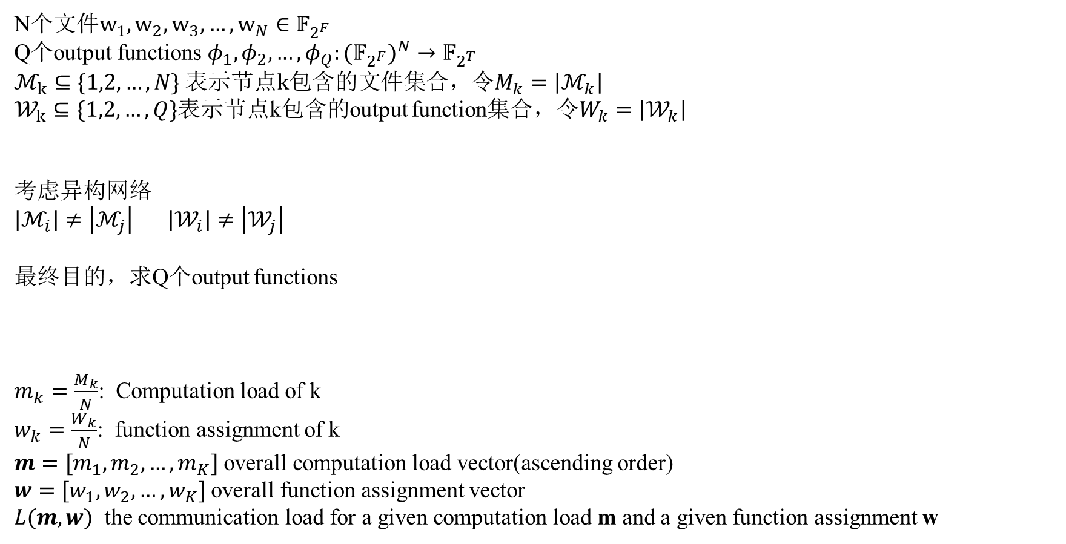
2. SYSTEM MODEL
N个$文件w_{1},w_{2},w_{3},…,w_{N}∈𝔽_{2^{F}}$
Q个output functions${ φ}_{1},φ_{2},…,φ_{Q}:{{(𝔽}_{2^{F}})}^{N}→𝔽_{2^{T}}$
$ℳ_{k}⊆\{1,2,…,N\}$ 表示节点k包含的文件集合，令$M_{k}=\left|ℳ_{k}\right|$
$𝒲_{k}⊆\{1,2,…,Q\}$表示节点k包含的output function集合，令$W_{k}=\left|𝒲_{k}\right|$
考虑异构网络
$\left|ℳ_{i}\right|≠\left|ℳ_{j}\right|$ $\left|𝒲_{i}\right|≠\left|𝒲_{j}\right|$
最终目的，求Q个output functions
$m_{k}=\frac{M_{k}}{N}$: Computation load of k
$w_{k}=\frac{W_{k}}{N}$: function assignment of k
$m=[m_{1}, m_{2},…,m_{K}]$ overall computation load vector(ascending order)
$w=[w_{1}, w_{2},…,w_{K}]$ overall function assignment vector
$L(m,w)$ the communication load for a given computation load m and a given function assignment w

Slide 5
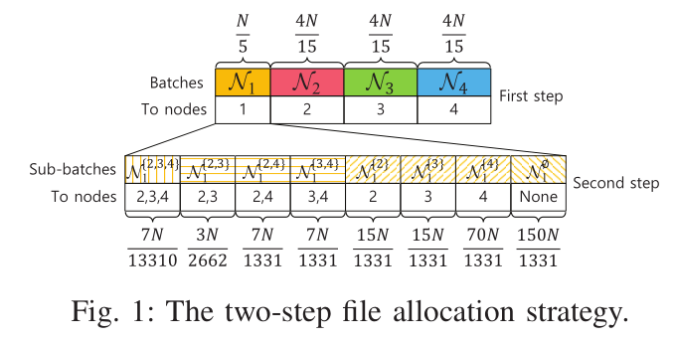
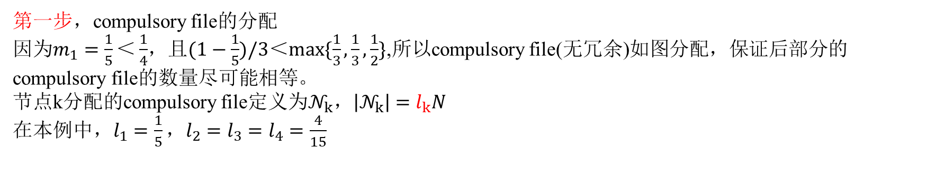
3. ACHIEVABLE COMMUNICATION LOAD AT GIVEN FUNCTION ASSIGNMENT w
$m=[\frac{1}{5},\frac{1}{3},\frac{1}{3},\frac{1}{2}]$ $w=[\frac{1}{8},\frac{1}{4},\frac{1}{6},\frac{11}{24}]$ $ℳ_{k}=$ compulsory file + optional file
第一步，compulsory file的分配
因为$m_{1}=\frac{1}{5}＜\frac{1}{4}$，且$(1−\frac{1}{5})/3＜max⁡\{\frac{1}{3},\frac{1}{3},\frac{1}{2}\}$,所以compulsory file(无冗余)如图分配，保证后部分的compulsory file的数量尽可能相等。
节点k分配的compulsory file定义为$𝒩_{k}，\left|𝒩_{k}\right|=l_{k}N$
在本例中，$l_{1}=\frac{1}{5}，l_{2}=l_{3}=l_{4}=\frac{4}{15}$

Slide 6





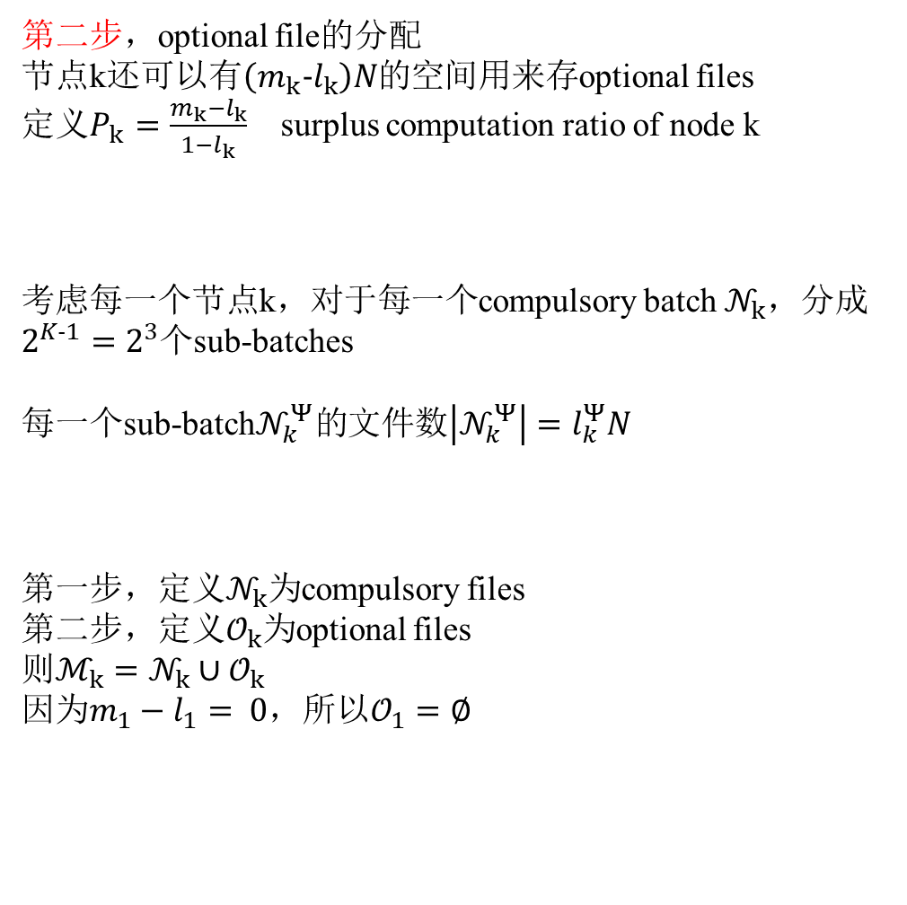
3. ACHIEVABLE COMMUNICATION LOAD AT GIVEN FUNCTION ASSIGNMENT w
$m=[\frac{1}{5},\frac{1}{3},\frac{1}{3},\frac{1}{2}]$ $w=[\frac{1}{8},\frac{1}{4},\frac{1}{6},\frac{11}{24}]$ $ℳ_{k}=$ compulsory file + optional file
第二步，optional file的分配
节点k还可以有$\left(m_{k}−l_{k}\right)N的$空间用来存optional files
定义$P_{k}=\frac{m_{k}−l_{k}}{1−l_{k}}$ surplus computation ratio of node k
考虑每一个节点k，对于每一个compulsory batch $𝒩_{k}$，分成$2^{K−1}=2^{3}$个sub-batches
每一个sub-batch$𝒩_{k}^{Ψ}的$文件数$\left|𝒩_{k}^{Ψ}\right|=l_{k}^{Ψ}N$
第一步，定义$𝒩_{k}$为compulsory files
第二步，定义$𝒪_{k}$为optional files
则$ℳ_{k}=𝒩_{k}∪𝒪_{k}$
因为$m_{1}−l_{1}= 0，$所以$𝒪_{1}=∅$
定义没有optional file的节点为low-computation-load (LowCL) nodes
定义有optional file的节点为high-computation-load (HighCL) nodes
节点1为LowCL nodes，节点2，3，4为HighCL nodes

Slide 7
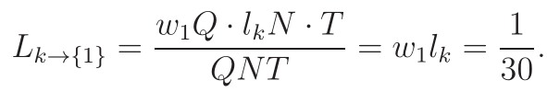
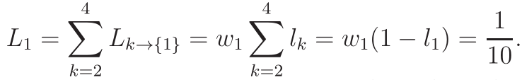
3. ACHIEVABLE COMMUNICATION LOAD AT GIVEN FUNCTION ASSIGNMENT w
$m=[\frac{1}{5},\frac{1}{3},\frac{1}{3},\frac{1}{2}]$ $w=[\frac{1}{8},\frac{1}{4},\frac{1}{6},\frac{11}{24}]$ 节点1为LowCL nodes，节点2，3，4为HighCL nodes
第三步，传给节点1(LowCL nodes)的shuffle规则
由于节点1是LowCL node，没有optional files，所以其他节点发给它的数据中不存在coded opportunities。
因此，传给节点1的方式是其他节点对节点1进行单播传输（不用xor）
所以对于节点k∈[2,3,4]
总传给节点1的总的传输量

Slide 8





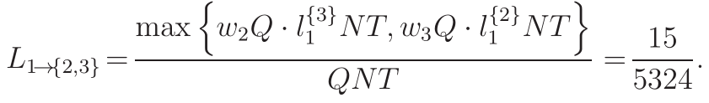
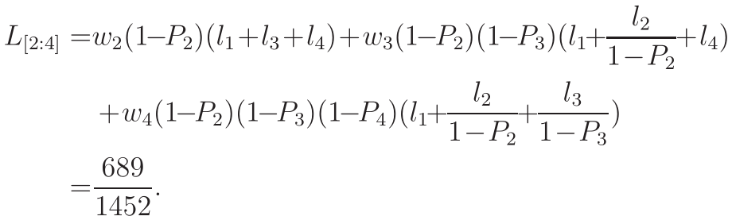

3. ACHIEVABLE COMMUNICATION LOAD AT GIVEN FUNCTION ASSIGNMENT w
第四步，传给节点[2:4](HighCL nodes)的shuffle规则
由于节点[2:4]有optional files(包含其他节点的compulsory file)，所以其他节点发给它的数据中存在coded opportunities。
所以对于节点 需要传送给节点k的中间值可以被定义为
考虑节点1发给{2,3}的情况
这两个发送数据存在coded opportunities
由于打破了对称性，这两个数据的长度不同，所以需要zero-padding处理
对于节点1发的，遍历接收组{{2},{3},{4},{2,3},{2,4},{3,4},{2,3,4}}，其他发送节点2、3、4同理可得

Slide 9
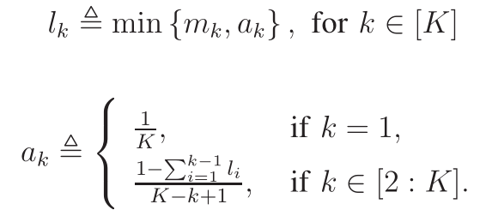


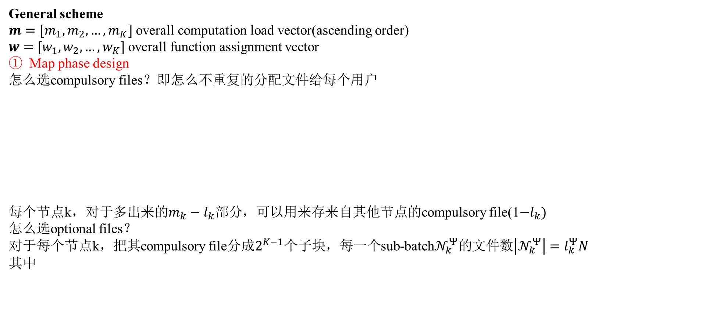



3. ACHIEVABLE COMMUNICATION LOAD AT GIVEN FUNCTION ASSIGNMENT w
General scheme
$m=[m_{1}, m_{2},…,m_{K}]$ overall computation load vector(ascending order)
$w=[w_{1}, w_{2},…,w_{K}]$ overall function assignment vector
Map phase design
怎么选compulsory files？即怎么不重复的分配文件给每个用户
每个节点k，对于多出来的$m_{k}−l_{k}部分$，可以用来存来自其他节点的compulsory file(1$−l_{k})$
怎么选optional files？
对于每个节点k，把其compulsory file分成$2^{K−1}$个子块，每一个sub-batch$𝒩_{k}^{Ψ}的$文件数$\left|𝒩_{k}^{Ψ}\right|=l_{k}^{Ψ}N$
其中
$$m_{K}$$
$$a_{K}$$
$$l_{K}$$
定义[r]为LowCL nodes
定义[r + 1 : K]为HighCL nodes
这样分满足每个节点存储大小$m_{K}$的约束

Slide 10
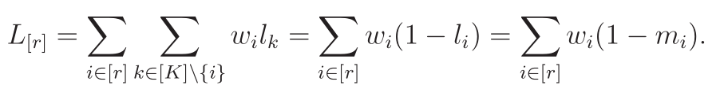

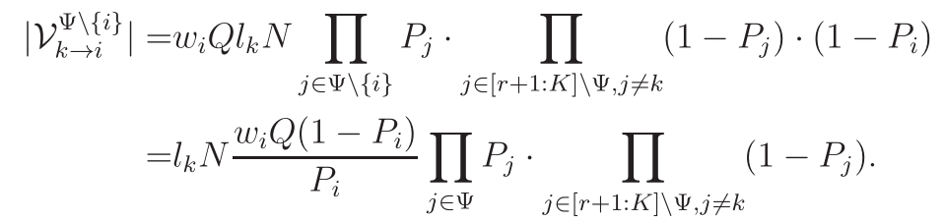

3. ACHIEVABLE COMMUNICATION LOAD AT GIVEN FUNCTION ASSIGNMENT w
General scheme
Shuffle phase design
Communication to LowCL nodes [r]，直接传
Communication to HighCL nodes [r+1 : K]，重点
考虑所有发送组$Ψ⊆[r+1:K]$

Slide 11

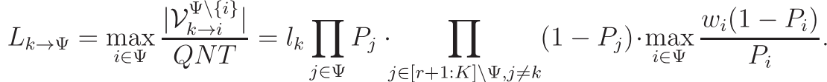

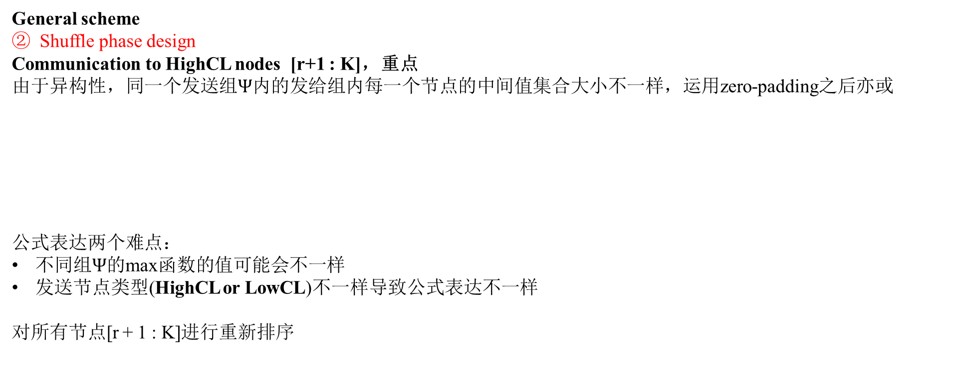
3. ACHIEVABLE COMMUNICATION LOAD AT GIVEN FUNCTION ASSIGNMENT w
General scheme
Shuffle phase design
Communication to HighCL nodes [r+1 : K]，重点
由于异构性，同一个发送组$Ψ$内的发给组内每一个节点的中间值集合大小不一样，运用zero-padding之后亦或
公式表达两个难点：
不同组$Ψ$的max函数的值可能会不一样
发送节点类型(HighCL or LowCL)不一样导致公式表达不一样
对所有节点[r + 1 : K]进行重新排序

Slide 12
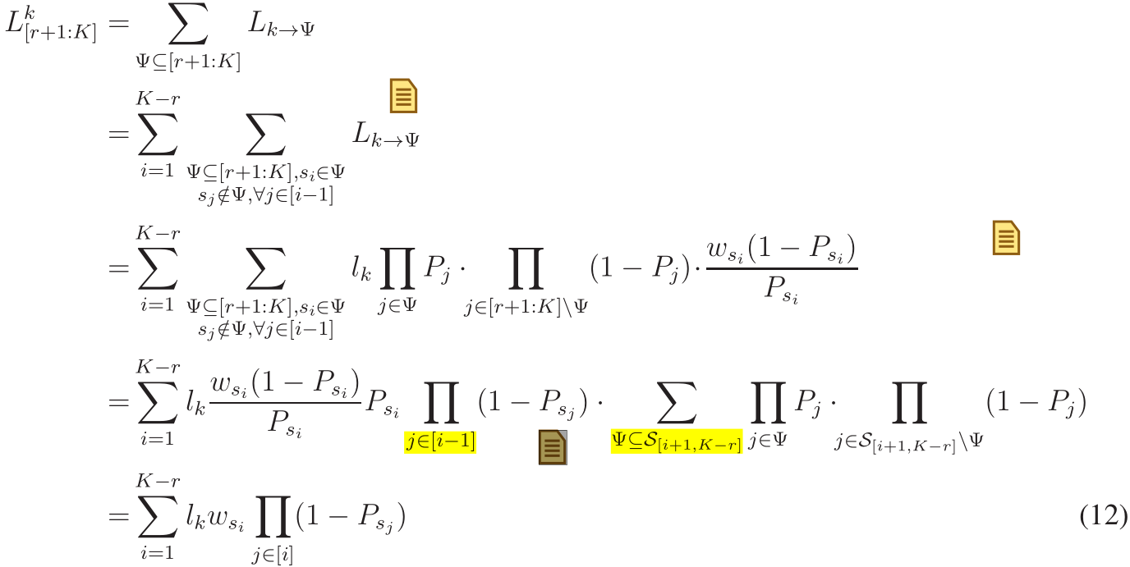
3. ACHIEVABLE COMMUNICATION LOAD AT GIVEN FUNCTION ASSIGNMENT w
General scheme
Shuffle phase design
Communication to HighCL nodes [r+1 : K]，重点
发送节点是LowCL nodes

Slide 13
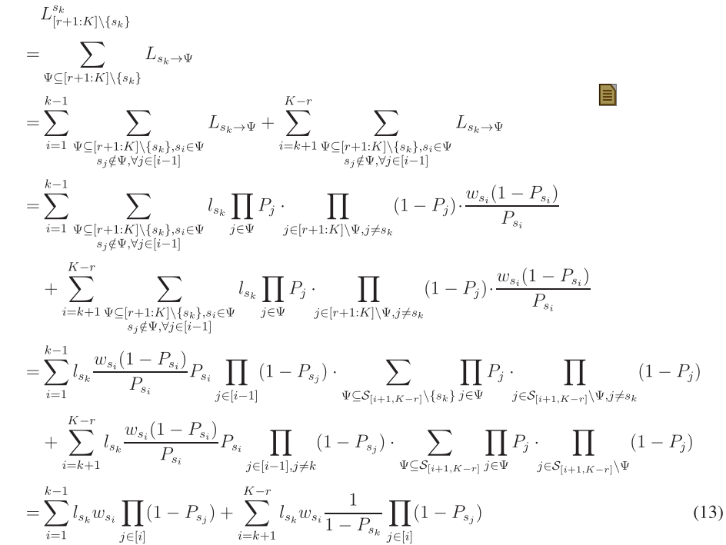
3. ACHIEVABLE COMMUNICATION LOAD AT GIVEN FUNCTION ASSIGNMENT w
General scheme
Shuffle phase design
Communication to HighCL nodes [r+1 : K]，重点
发送节点是HighCL nodes

Slide 14
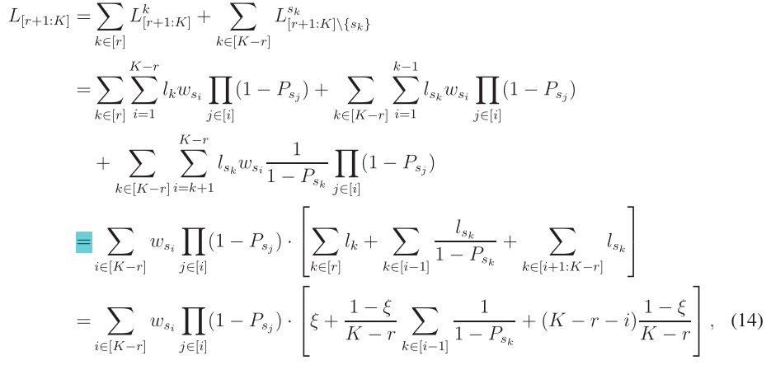
3. ACHIEVABLE COMMUNICATION LOAD AT GIVEN FUNCTION ASSIGNMENT w
General scheme
Shuffle phase design
两种情况的传输量加起来

Slide 15
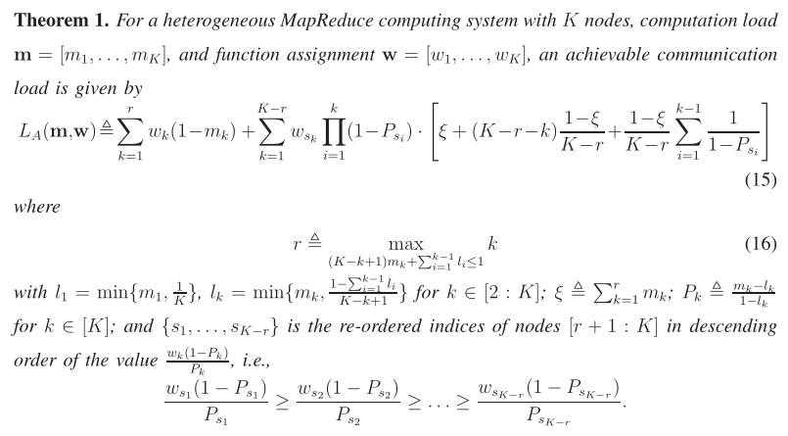
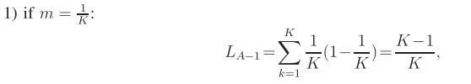
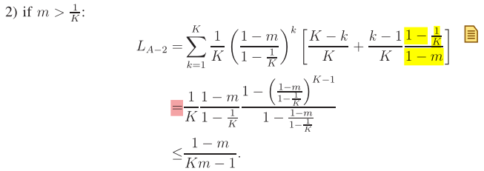


3. ACHIEVABLE COMMUNICATION LOAD AT GIVEN FUNCTION ASSIGNMENT w

Slide 16

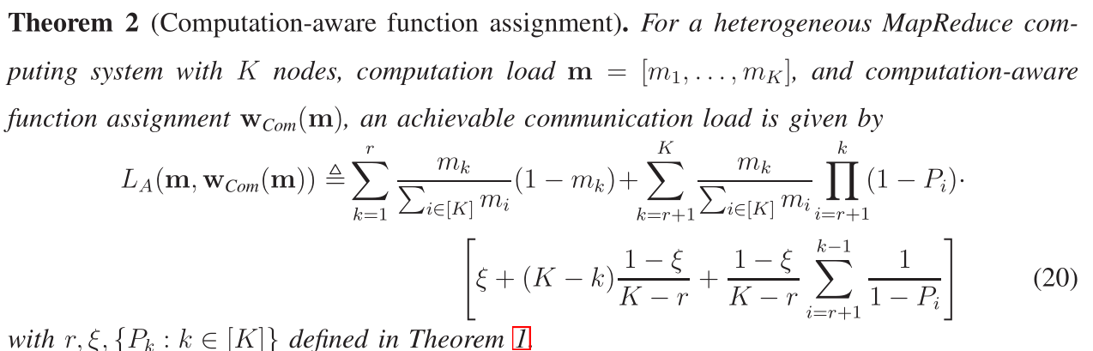
4.FUNCTION ASSIGNMENTS
直观上，一个节点存的文件多，那么存的output functions也应该对应多些
本文提出两种方式： computation-aware and the shuffle-aware function assignments
Computation-aware function assignment
Function分配与文件分配成比例

Slide 17

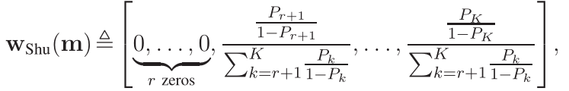
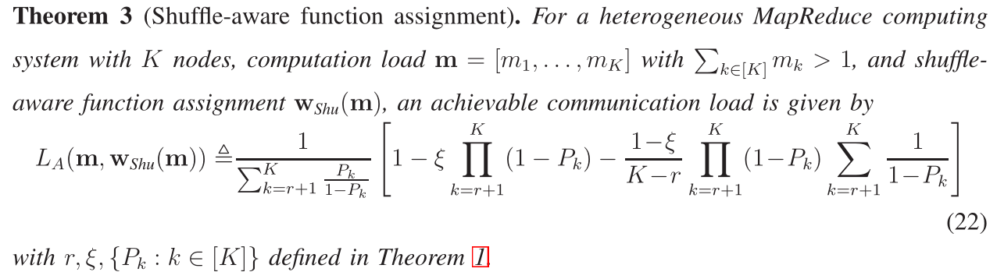
4.FUNCTION ASSIGNMENTS
Computation-aware function assignment
避免使用zero-padding，使传输过程具有对称性，我们令
对于HighCL nodes，我们令
对于LowCL nodes,我们直接不存functions

Slide 18
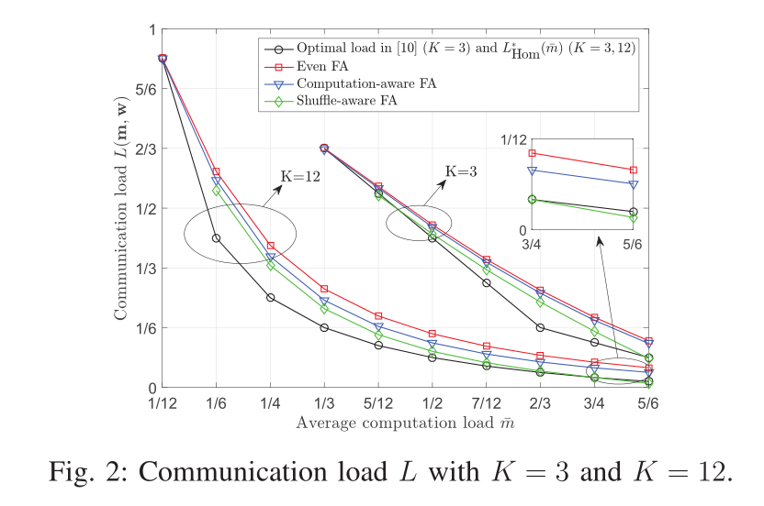
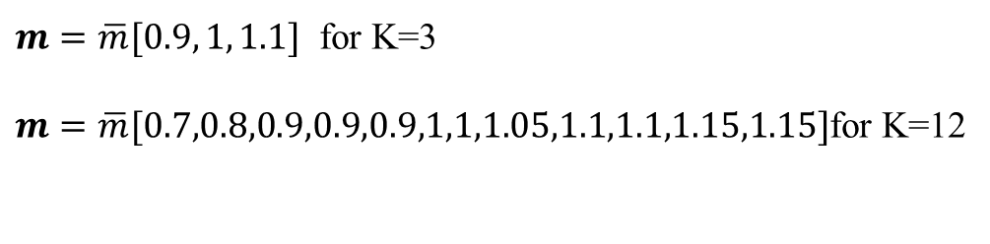
4.FUNCTION ASSIGNMENTS(Comparison with other works)
关于传输量 (横坐标以平均值来衡量)
$m=\overline{m}[0.9, 1, 1.1]$ for K=3
$m=\overline{m}[0.7,0.8,0.9,0.9,0.9,1,1,1.05,1.1,1.1,1.15,1.15]$for K=12
shuffle-aware function assignment 得到最小的传输量
even function assignment(function平均分)得到最大的传输量

Slide 19
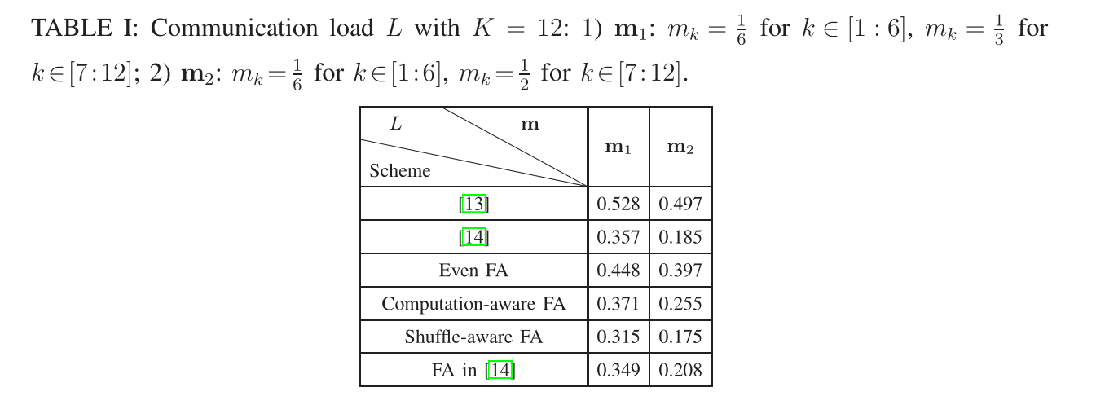
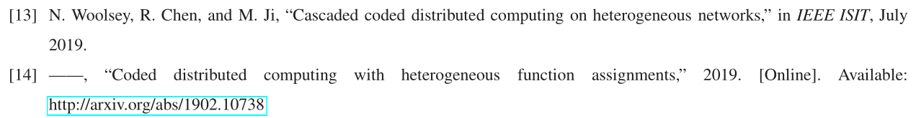
4.FUNCTION ASSIGNMENTS(Comparison with other works)
关于和其他文章的传输量比较
[13]和[14]都是N. Woolsey等人提出
Shuffle-aware FA得到最好的性能，因为避免了zero-padding保持了传输过程的对称性
[14]本质上也是避免了zero-padding，因此性能也不错

Slide 20
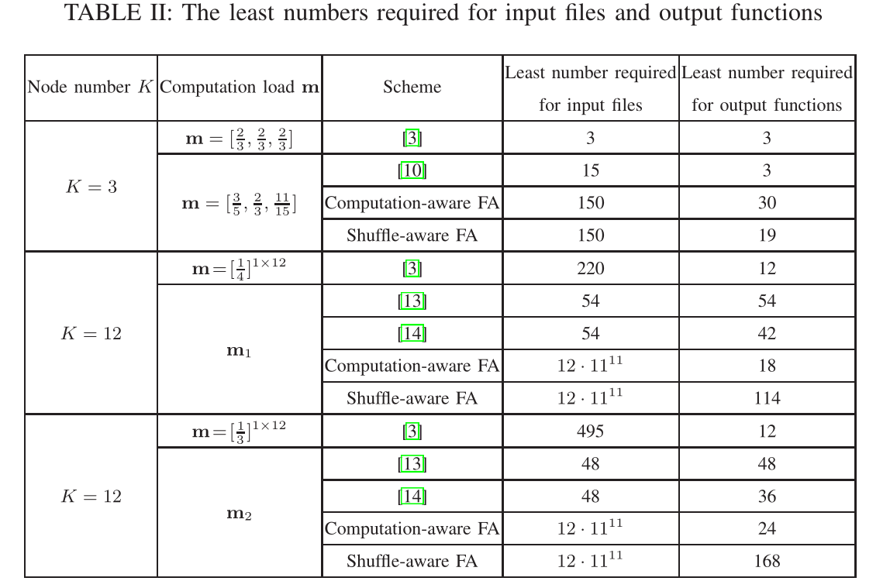
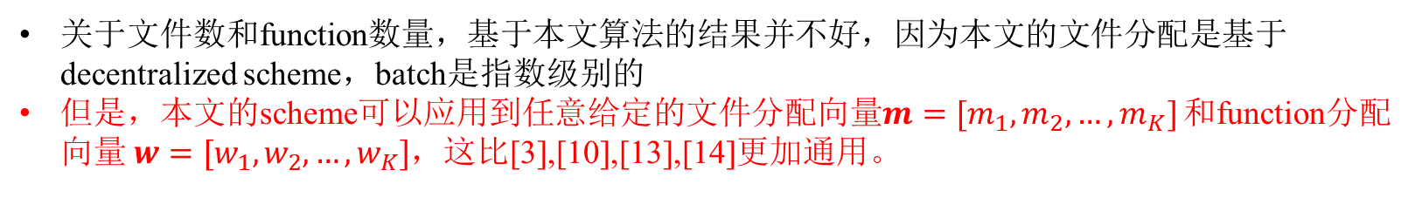
4.FUNCTION ASSIGNMENTS(Comparison with other works)
关于文件数比较
关于文件数和function数量，基于本文算法的结果并不好，因为本文的文件分配是基于decentralized scheme，batch是指数级别的
但是，本文的scheme可以应用到任意给定的文件分配向量$m=[m_{1}, m_{2},…,m_{K}]$ 和function分配向量 $w=[w_{1}, w_{2},…,w_{K}]$，这比[3],[10],[13],[14]更加通用。

